Slide 1

CROWD COUNTING USING SEMI-SUPERVISED DEEP LEARNING: A WEB-BASED APPROACH
23MIA1020- Bhuvan Rajesh
23MIA1122- Mohana Ramanan
23MIA1168- Shruthi Arunkumar

Slide 2


INTRODUCTION
Crowd analysis plays a critical role in public safety and urban management. Given the limitations in annotated datasets, this project explores a semi-supervised learning paradigm to improve crowd counting accuracy with sparse labeling. Leveraging patch-wise regression and a blend of supervised and unsupervised learning, the system demonstrates robust crowd density estimation across varied scenes. The flexible, modular Python implementation can be easily deployed and adapted for practical deployment.

Slide 3


MOTIVATION
Accurate crowd counting is integral for event monitoring, public space safety, and smart-city analytics. Traditional approaches are hindered by the expense and difficulty of acquiring large-scale, densely-annotated datasets. The motivation for this project is to overcome challenges posed by limited ground-truth data, frequent occlusions, and visual clutter. By employing semi-supervised learning, the proposed framework not only reduces annotation requirements but also enhances adaptability in new environments.

Slide 4
BASE PAPER SUMMARY
Objective: Improve crowd counting accuracy with less annotation effort by combining CNNs (for local details) and Transformers (for global context), enabling training using only count-level (not point-level) supervision.
Approach: The CrowdCCT model integrates DenseNet121 (CNN) with two Transformer modules—Multi-Scale Dilated Attention (MSDA) for scale robustness and Location-Enhanced Attention (LEA) for focus on person localization.
Results: Tested on four public datasets, CrowdCCT outperforms existing weakly supervised approaches and achieves results competitive with fully supervised models. It handles diverse crowd densities, lighting, and weather.
Significance: Demonstrates the effectiveness of combining local and global feature extractors and reduces the need for labor-intensive annotations in crowd analysis.
Keywords: Crowd Counting, Weak Supervision, CNN, Transformer, Attention Mechanisms

Slide 5
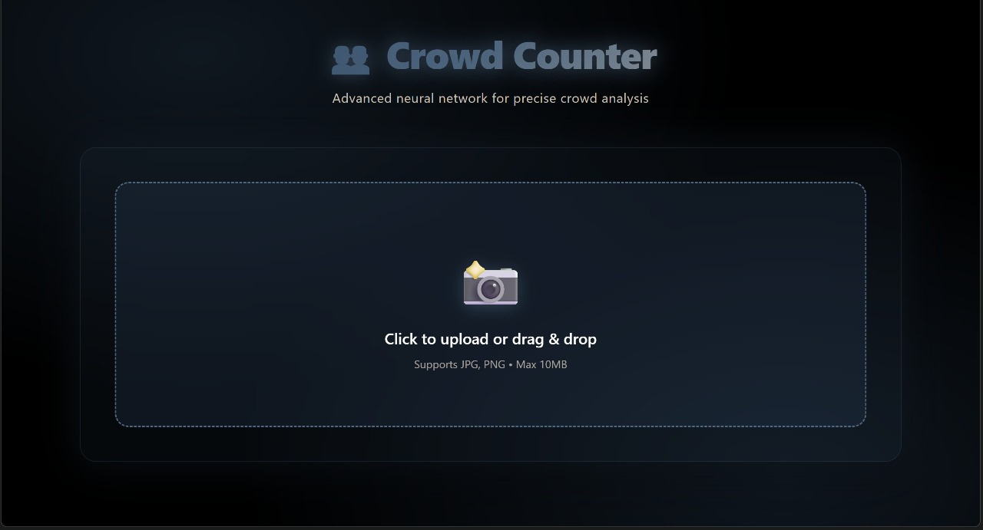
RESULTS

Slide 6
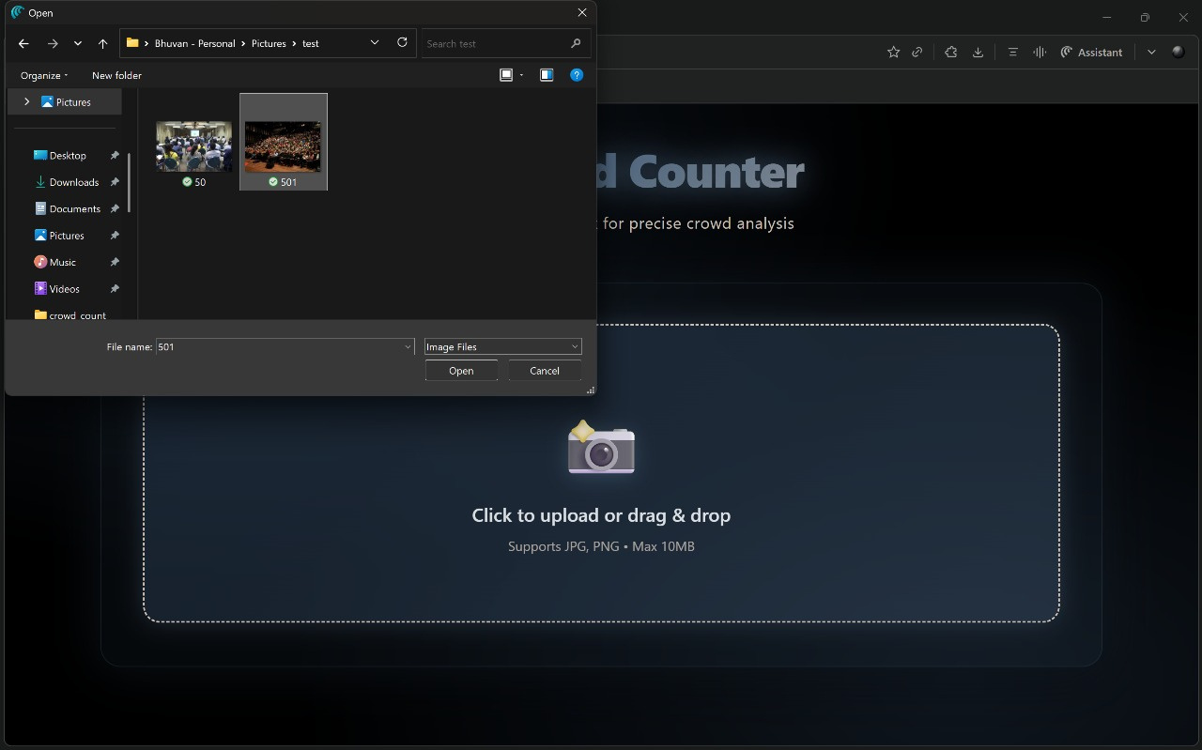
RESULTS

Slide 7
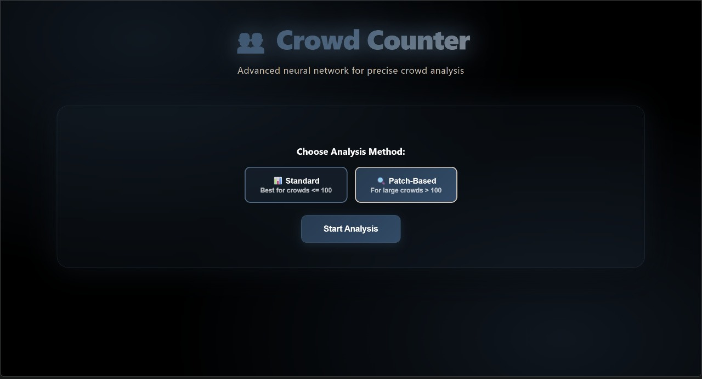
RESULTS

Slide 8
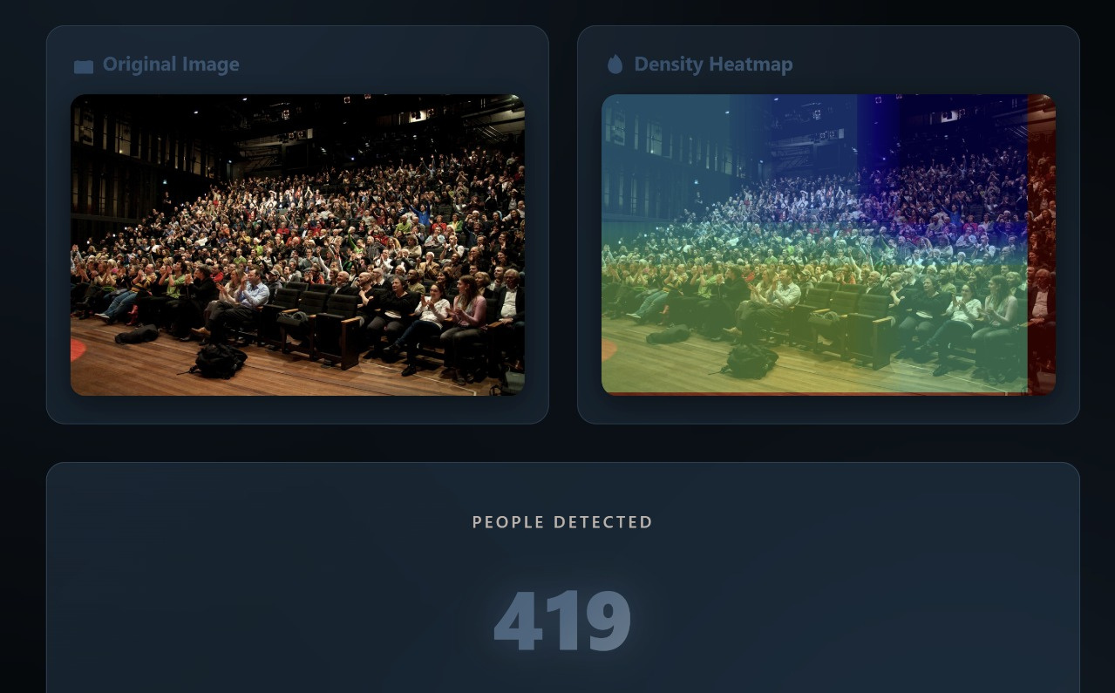
RESULTS

Slide 9
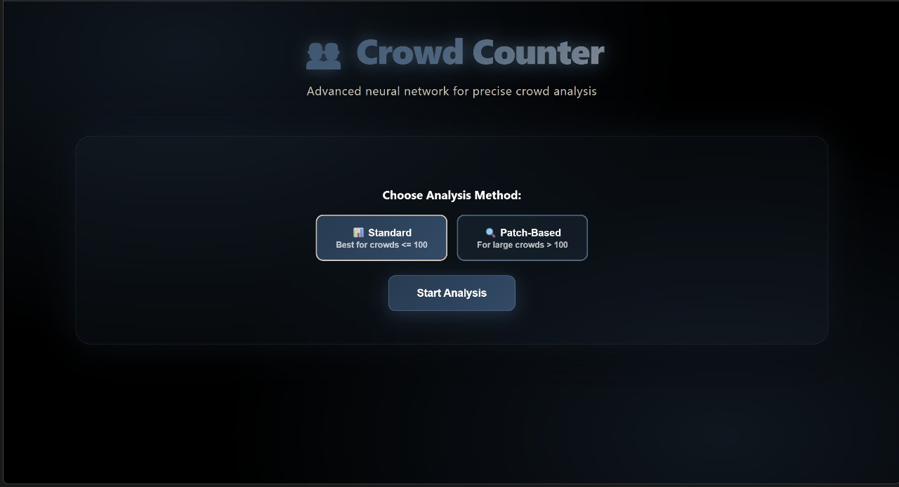
RESULTS

Slide 10
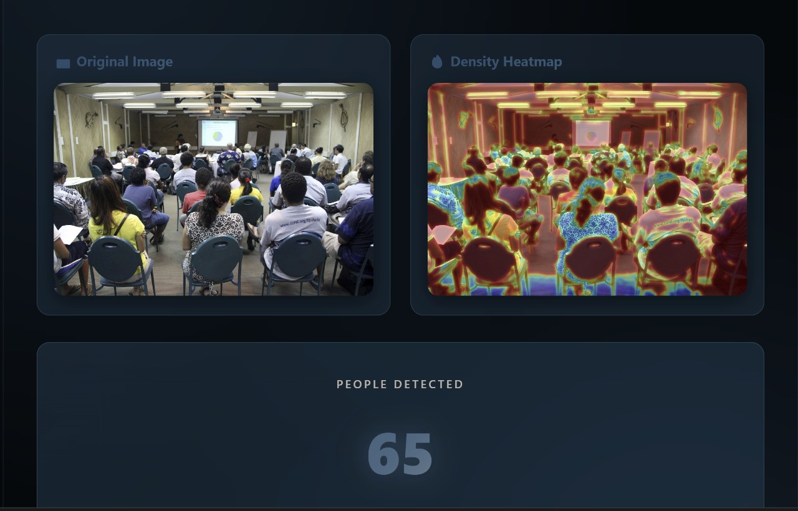
RESULTS

Slide 11
[Input Images]
|
v
[Preprocessing/Augmentation] ---> [Patch Generation]
|
v
[Feature Extraction Network]
|
v
[Supervised Loss <--- Labeled Data] <--+
|
[Pseudo-Labeling/Consistency Loss <--- Unlabeled Data]
|
v v
[Patch Density Prediction] [Patch Density Prediction]
\_______________ _______________/
| |
[Density Aggregation]
|
v
[Crowd Count Output & Density Map]
|
v
[Results Storage & Deployment]
METHODOLOGY FLOW DIAGRAM

Slide 12
KEY ENHANCEMENTS
[Current Enhancements:
Patch-Based Analysis: Precise counting by dividing images into small patches for localized density estimation.
Semi-Supervised Workflow: Combines labeled and unlabeled data, reducing annotation burden and improving model generalization.
Enhanced Data Pipeline: Incorporates advanced augmentation and preprocessing for robust training.
Containerized Deployment: Docker-based setup for reproducible experiments and easy scaling.
Future Scope:
Domain Adaptation: Extend model to new environments and camera perspectives with minimal retraining.
Active Learning: Integrate querying for the most informative labels, further lowering annotation requirements.
Temporal Crowd Analysis: Expand to video streams for real-time density tracking and anomaly detection.
Broader Dataset Integration: Validate and refine the model on larger, more diverse datasets.

Slide 13
THANK YOU

